Slide 1

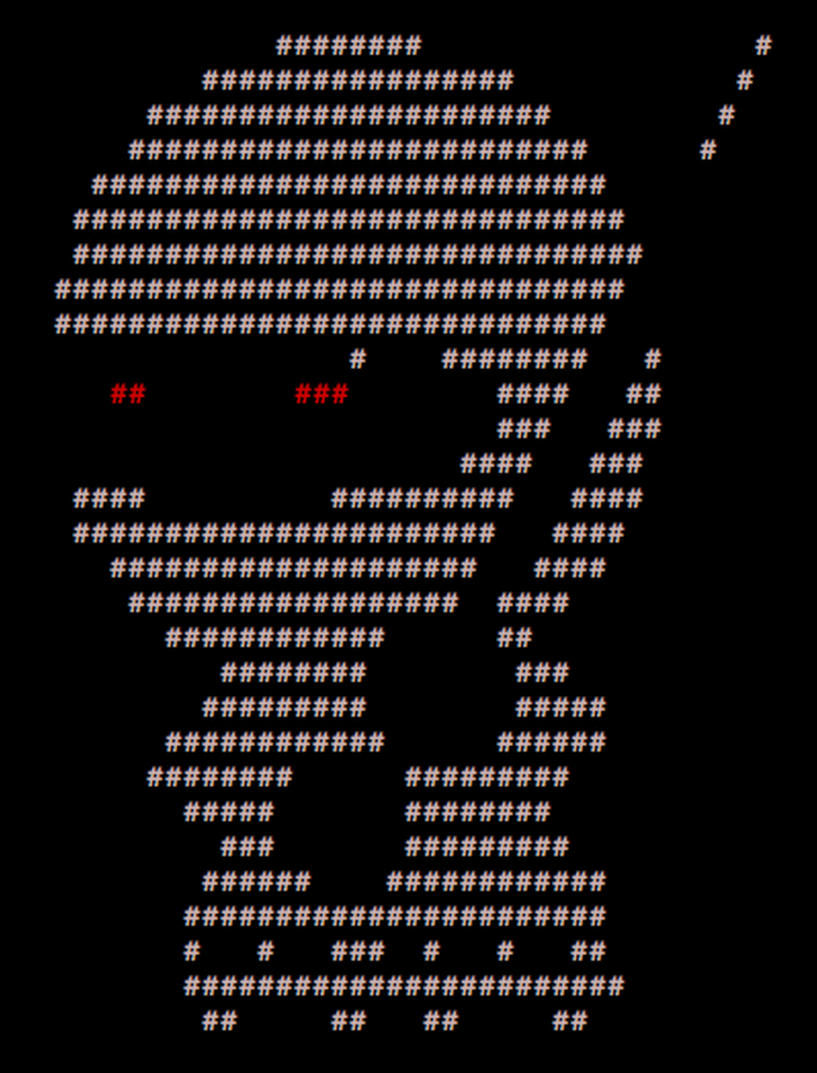
[SecTalks] Perth 2016 PER0x24
____ _____ _ _
/ ___| ___ __|_ _|_ _| | | _____
\___ \ / _ \/ __|| |/ _` | | |/ / __|
___) | __/ (__ | | (_| | | <\__ \
|____/ \___|\___||_|\__,_|_|_|\_\___/
PER0x24
Technical (in)security talks & hands-on challenges, no bullshit!
Technical (in)security talks & hands-on challenges, no bullshit!

Slide 2
Welcome!
[SecTalks] Perth 2016 PER0x24
Hello Nerds
Technical (in)security talks & hands-on challenges, no bullshit!

Slide 3
SecTalks PER0x24
[SecTalks] Perth 2016 PER0x24
Thanks to…
Kate (Spacecubed) and Aaron + Sam (Hivint), for arranging free rooms
BEER FROM PEOPLE
BURGER SPONSOR – THIS COULD BE YOU
Our volunteers tonight - nidogski & doles
Technical (in)security talks & hands-on challenges, no bullshit!

Slide 4
Speakers PER0x24
[SecTalks] Perth 2016 PER0x24
#1 N1nj4 N1gh7
boot2root box with 11 flags to collect on your way to completing.
There is no real entry hurdle by way of skills required, and help is on hand!
Technical (in)security talks & hands-on challenges, no bullshit!

Slide 5
Speakers PER0x24
[SecTalks] Perth 2016 PER0x24
Notes:
- DHCP (Automatically assigned).
- IMPORTANT: The VM IS working as intended if you receive a successful DHCP lease as seen in the boot up sequence.
- The VM MUST be on the same subnet as the attacking machine. Ideally both the boot2root VM and the attacking machine should be on the same HostOnly network.
Walkthroughs DO exist online, but you won’t learn as much if
you just follow them step by step!
Technical (in)security talks & hands-on challenges, no bullshit!

Slide 6
SecTalks PER0x25
[SecTalks] Perth 2016 PER0x24
Date: December 2016 TBC, 17:30
Speaker: ???
Title: ???
http://j.mp/sectalkscfp
Technical (in)security talks & hands-on challenges, no bullshit!

Slide 7
B33rz
[SecTalks] Perth 2016 PER0x24
Canton Bar
~ ~
( o )o)
( o )o )o)
(o( ~~~~~~~~o
( )' ~~~~~~~'
( )|) |-.
o| _ |-. \
o| |_||_) | \ \
| | ||_) | | |
o| | / /
| |." "
| |- '
.========.
Technical (in)security talks & hands-on challenges, no bullshit!

Slide 8




Stay in touch
[SecTalks] Perth 2016 PER0x24
IRC / SLACK
irc.sectalks.org > #sectalks (there is some awesome slack goodness for the truly 1337 as well ask on the list for an invite)
Mailinglist
http://groupspaces.com/sectalks/join
Github
https://github.com/sectalks/sectalks
Twitter
@SecTalks
Technical (in)security talks & hands-on challenges, no bullshit!

Slide 9
Without further ado...
[SecTalks] Perth 2016 PER0x24
Burgers (maccas)
bar
Technical (in)security talks & hands-on challenges, no bullshit!

